Slide 1
Analyzing openBIS datasets with Jupyter & MATLAB
Henry Lütcke
Scientific IT Services, ETH Zurich
openBIS Training, 23.01.2020
Slides / materials: http://u.ethz.ch/YFHNg
Notes:
Introduce ourselves
Mention that slides will be made available!

Slide 2
Why Jupyter notebooks?

Slide 3
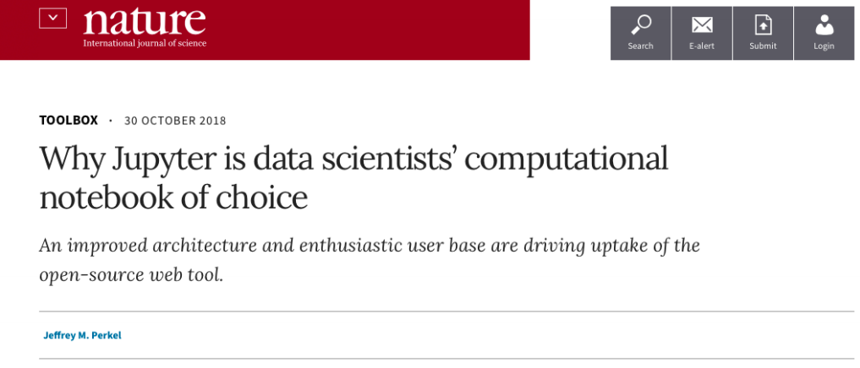
Why Jupyter notebooks?
Jupyter notebooks combine documentation, code, input and output generated by the code (e.g. graphs, plots, images, videos)
Notes:
HL

Slide 4
Why Jupyter notebooks?
Jupyter notebooks combine documentation, code, input and output generated by the code (e.g. graphs, plots, images, videos)
Useful for interactive / exploratory data analysis and reproducibility
> 40 programming languages supported (Julia, Python, R, Scala, Matlab, etc)
Different programming languages can be mixed
Easily share code, documentation and results
It can even act as a modern lab notebook
Modern, web-based UI
Notes:
HL

Slide 5
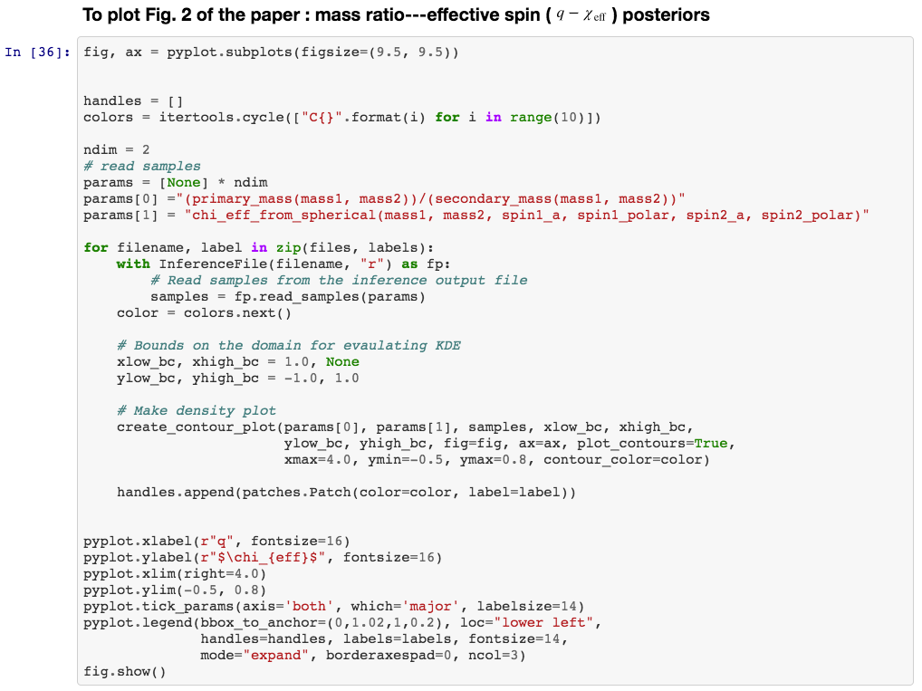
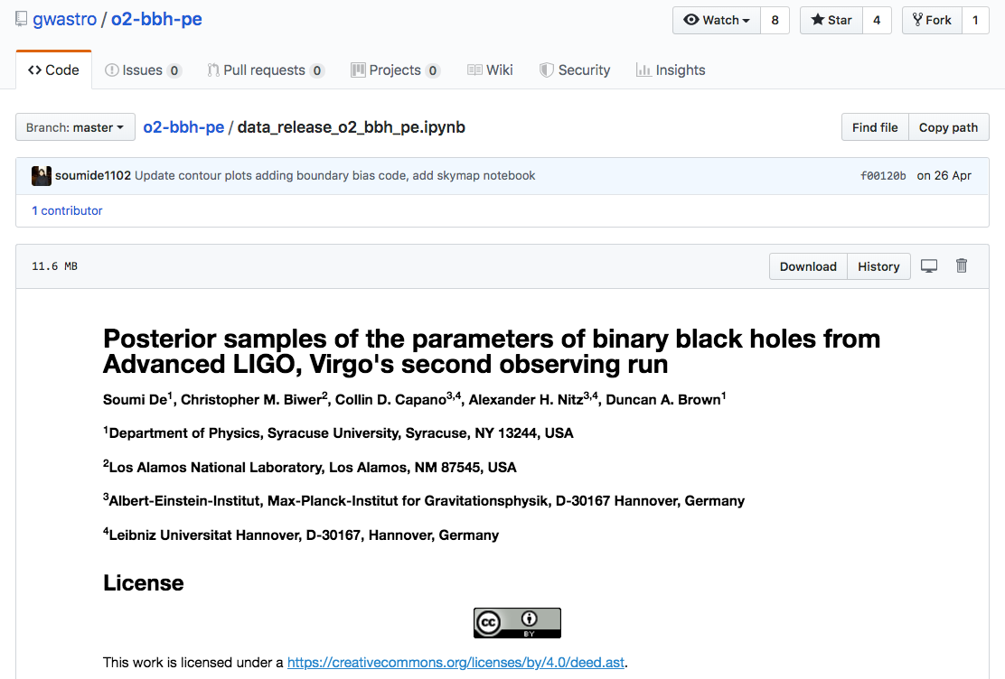
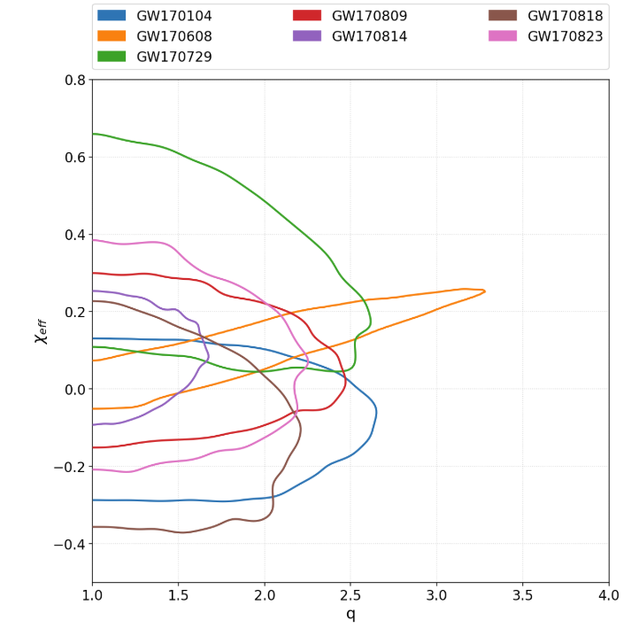
Jupyter notebook examples
Gravitational wave physics
Notes:
HL

Slide 6
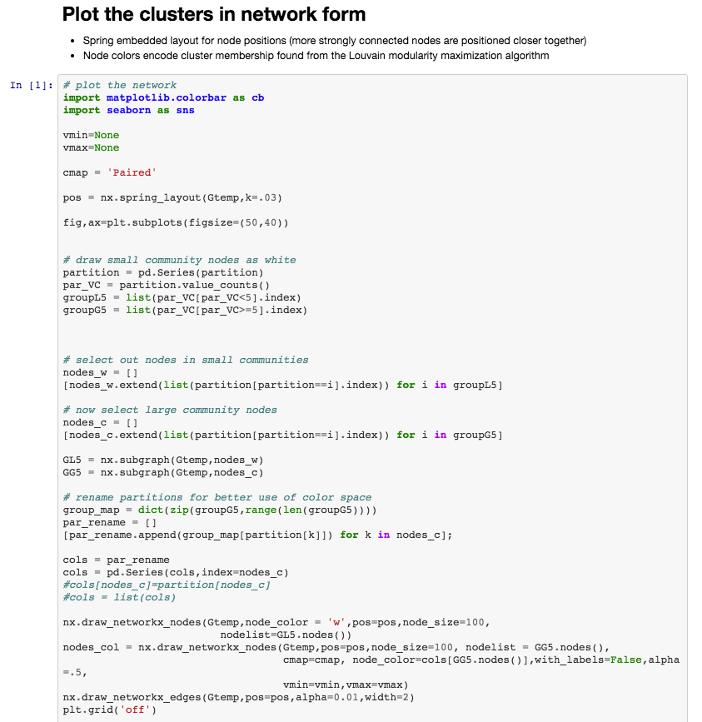
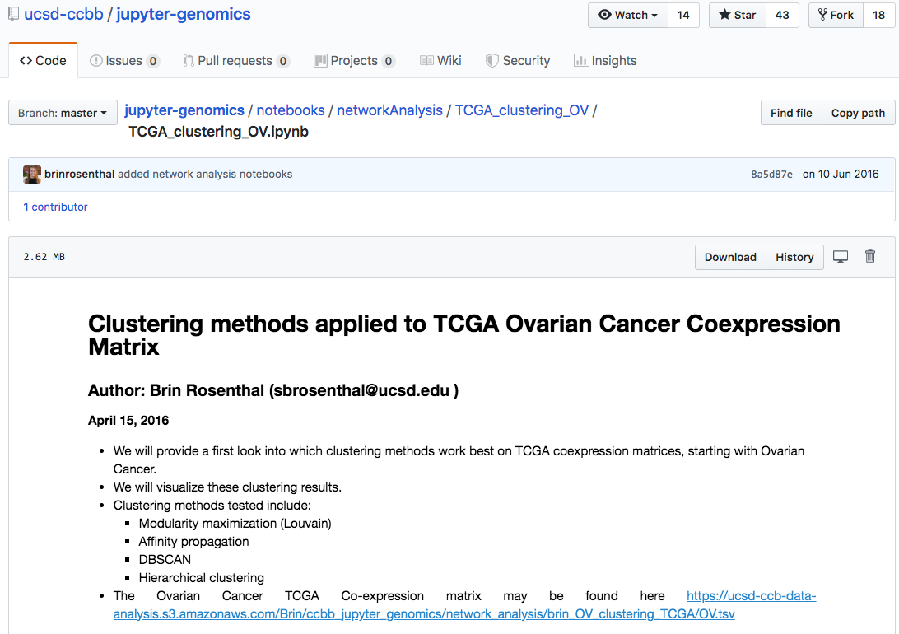
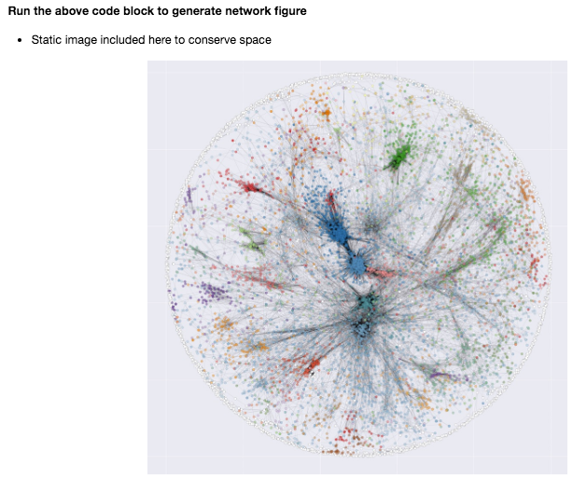
Jupyter notebook examples
Cancer genomics analysis
Notes:
HL

Slide 7
Options for running Jupyter notebooks

Slide 8
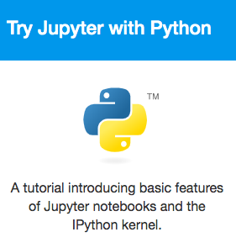
Options for running Jupyter
Local installation on your computer
Dedicated JupyterHub server (e.g. running on virtual machine in the cloud)
Public cloud-based offerings
MyBinder: https://mybinder.org/
Google cloud: https://colab.research.google.com/notebooks
EGI Notebooks: https://notebooks.egi.eu/hub/login
To get started
https://jupyter.org/try
Notes:
HL

Slide 9
Local installation of Jupyter
Option 1: Anaconda platform
Download / install Anaconda for your OS: https://www.anaconda.com/distribution/
Installs Jupyter, Python, R (+ >1’500 other packages)
Start notebook from Anaconda launcher
Option 2: Python only installation
Download / install Python for your OS: https://www.python.org/downloads/
Open the command line and type:
pip install --upgrade pip
pip install --upgrade ipython jupyter
Open the command line and type: jupyter notebook
Notes:
HL

Slide 10

Combining openBIS & Jupyter notebooks

Slide 11

openBIS & Jupyter
openBIS: data management + ELN-LIMS
Jupyter: interactive, reproducible data analysis
openBIS + Jupyter: full provenance tracking of data, analysis and results
Upload Results
Update Metadata
Retrieve Data
& Metadata
Notes:
HL

Slide 12
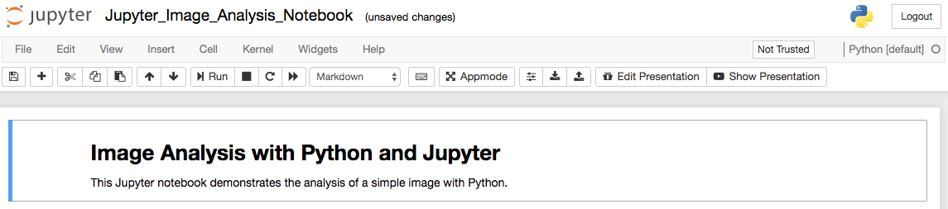
openBIS & Jupyter
Option 1: From Jupyter to openBIS
Install the Jupyter extension for openBIS: pip install --upgrade jupyter-openbis-extension
Notes:
HL

Slide 13
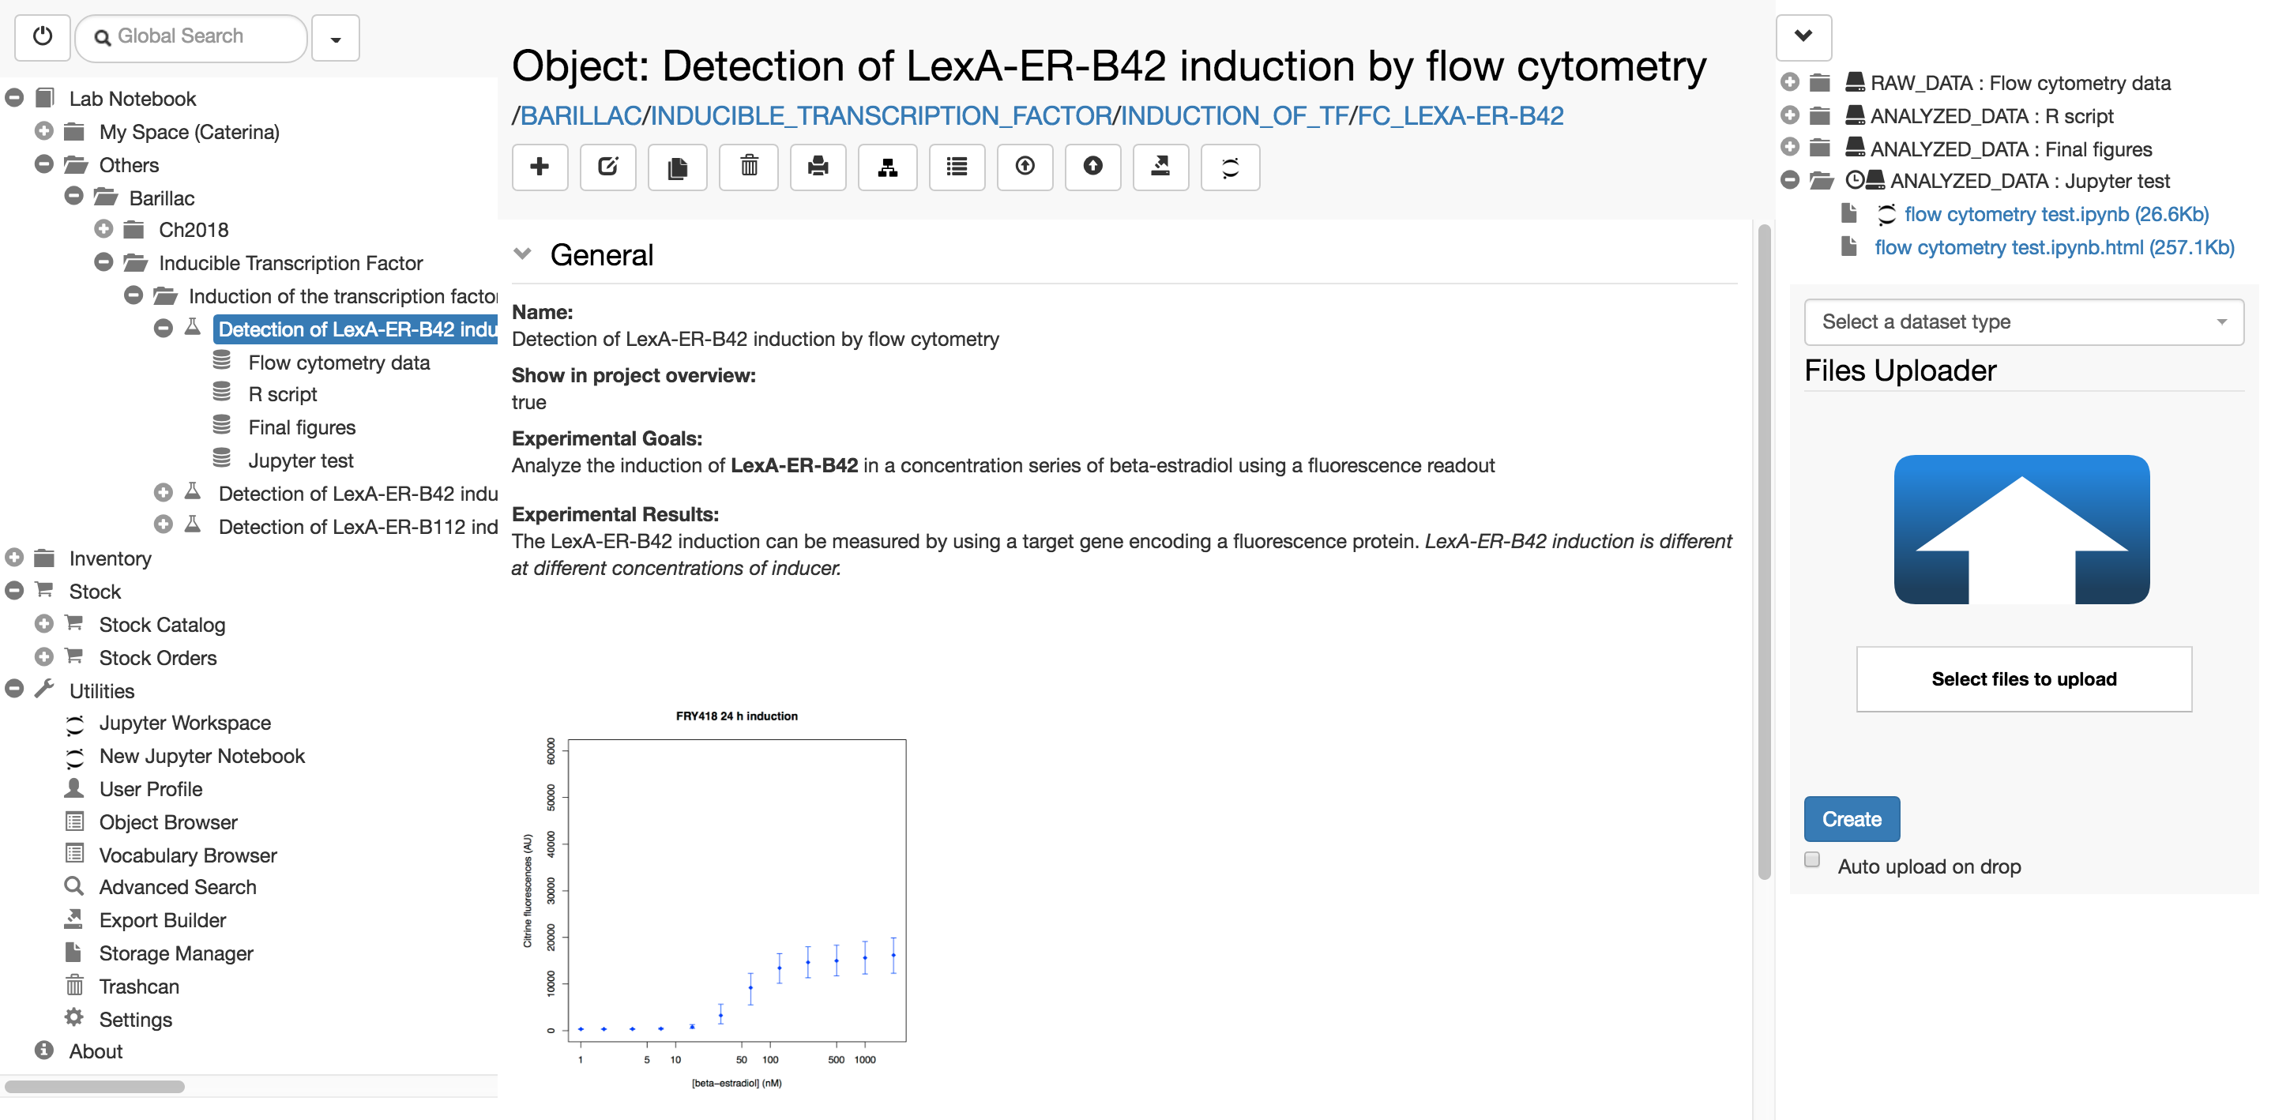
openBIS & Jupyter
Option 2: From openBIS to Jupyter
Notes:
HL

Slide 14
Using openBIS with MATLAB

